Slide 2















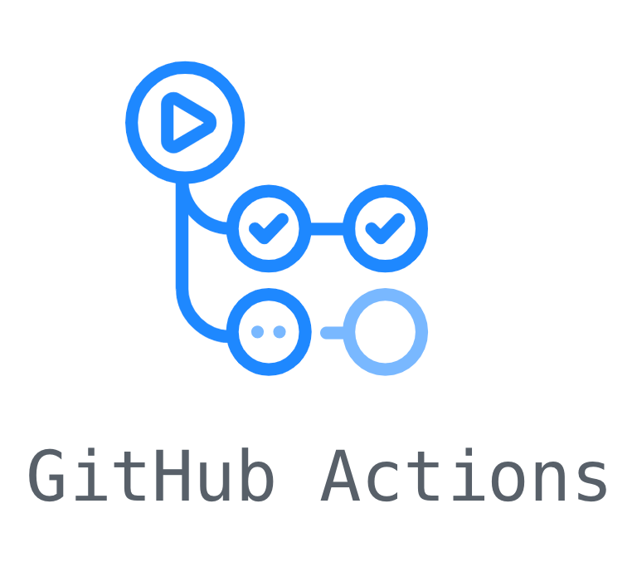

Front-end
Back-end
Database
ETC
Testing
Deploy
Language

